Slide 1

Education for Sustainable Development
in Protected Areas and Biosphere Reserves
Public participation and stakeholder involvement in promoting the management of the Amazon Forest Area in Leticia (CO).
Maria Christakou
Sermin Durdu
Charline Piot
Francesca Eliana Rigato

Slide 2
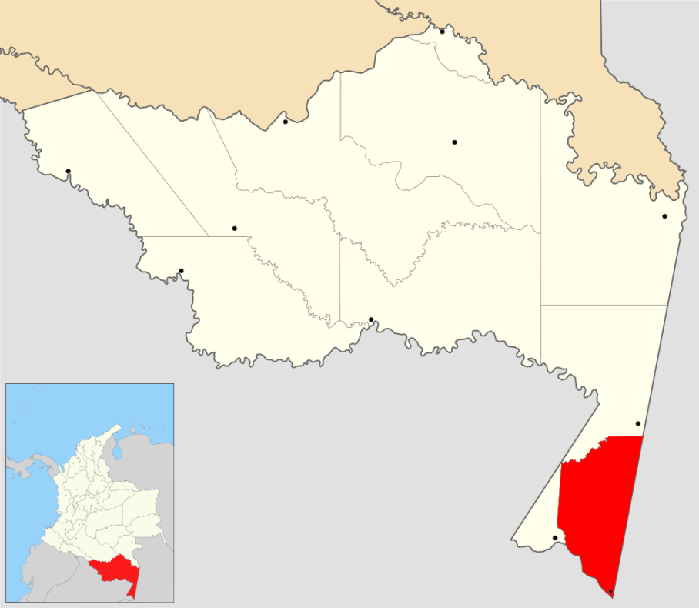

Introduction
Methodology
Results
Conclusion-Recommendations
Geographical position
Short history
Sustainable Tourism & Ecotourism
Tourism : Amacayacu National Natural Park
“Tourism that takes full account of its current and future economic, social and environmental impacts, addressing the needs of the visitors, the industry, the environment and the host communities.”
Aims
To make local products more attractive
To ensure the public participation and the stakeholder involvement.
To start an education program for sustainable management.
To develop new activities based on eco-tourism.

Slide 3
Introduction
Methodology
Results
Conclusion-Recommendations
Local People
NGOs
Ministary of Sustainable Development
Stakeholders
Why this topic : Personal Experience
Brainstorming
Ensuring Public Participation
Management of the Area
ESD
Literature research
SWOT analysis
Interview Professors Scoulos, Tuncay & Biasutti
Play roles

Slide 4
Introduction
Methodology
Results
Conclusion-Recommendations
Strenghts
Weaknesses
Threats
Opportunities
Potential for Tourism
Biodiversity
Suitable Landscape
Accomodations
Rainforest climate
Lack of Job Opportunity
No Social Activity
Mosquitos
Water Potential
3 Nationalities
Wilderness survival
Ecoproducts
Conflict between new activities
& local culture

Slide 5
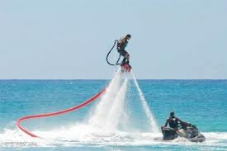
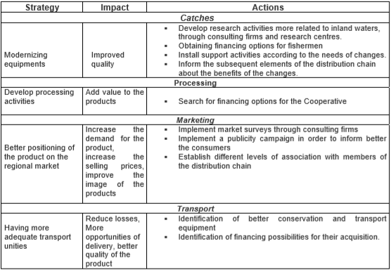
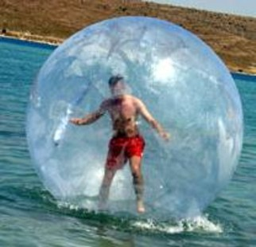
Introduction
Methodology
Results
Conclusion-Recommendations
Development of a future market for fishes in the Area
Education For Sustainable Development (ESD)
Ecotourism
Conclusion: just information is not enough,
the key of success is evolution of minds and changing attidutes through ESD

Slide 6

Thank you for your attention!
Merci pour votre attention!
Grazie per l’attenzione!
Dinlediginiz için tesekkürler!
Σας ευχαριστούμε για την προσοχή σας!

